Slide 1

CGC_REBOUNDER Team member Bhawna Rajput(Captain)-Android Developer Himanshu Kumar-Embedded Developer Surendra Singh Hada-Embedded Developer

Slide 2
Content
Uses Of Petroleum
Frauds
Steps Taken By Government
Similar Device
Disadvantage over Our Product

Slide 3
USES OF PETROLEUM
Transportation for running the vehicles.
In power stations where diesel is used to produce electricity.
For smooth running of machines, in which lubricating oil is used.
For domestic and lightning purposes in which kerosene is used.
After All Everyone Wants Value to their Money No one Wants to get cheated

Slide 4
FRAUDS-!
When you ask them to fill petrol for Rs 1,000 , the attendant fills up the oil only for Rs 200 .
When you ask him why he didn't fill up for Rs 1,000 .
He will give a innocent smile and say that he heard Rs 200
he resets the meter and fills up another Rs 800 petrol and you pay Rs 1,000
What’s the scam here ?
The problem is that he never resets the meter to 0.
The trick here is that when he says that he is resetting the meter to 0 and moves towards it, at that some moment, another team mate of attendant will disturb you with some question like – “Sir, Cash or Card?” , or “Sir, PUC karana hai kya?” , Or “Sir can you fill up this coupon ?” .
As a human tendency – you will have to look at him or hear him and in those 3-4 seconds , the main attendent will start the meter again and by the time you look at the meter, its somewhere near 300-400

Slide 5
FRAUDS-!!
When you ask them to fill petrol for Rs 100 , the attendant fills up the oil.
And you will check the Meter Accurately with Price money of Rs 100 , and the Volume reading of Approx 1lt or above as the current Price
What’s the scam here ?
The problem is that he never Fills the shown volume .
There occurs the illusion Factor what the customer see and what is exactly Hapening
The trick here is that when You says to Fill up the Meter with Rs 100 , at that Time the Half Quantity of Petrol is Left in between the Pipe of The Dealer and this is how whole Fraud takes Place
Well the reading will show the Exact volume Dropped out of the Tank not through the Pipe

Slide 6
STEPS TAKEN BY GOVERNMENT
There is not Even a single step taken by our Government
Sometimes they use to inspect the Petrol Pumps such as
Oil minister Dharmendra Pradhan ordered an inspection of all petrol pumps in Uttar Pradesh and random checks elsewhere to detect short-selling of petrol and diesel by tampering with the system in dispensing units.
But they move Over after that no even a single inspection takes place and they are free to do their work what ever they want.

Slide 7
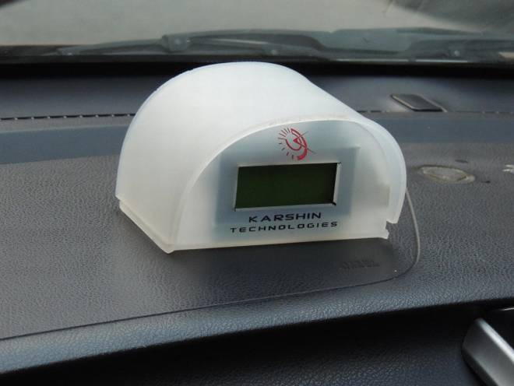

Similar Device
The appliance has a display screen and when installed in a vehicle records the exact quantity of fuel filled during each refill.
Adding that this helps some petrol pump attendants to hoodwink customers.

Slide 8
Disadvantage over Our Product
This uses a Device which we have to store at some definite Place as shown in the Pic.
Everyone Does not have a Car who can insert and use this Device
The Middle class persons wants value to their Money
Our Device is attachable to the Android Device and hence everyone in now Generation have Android Device and can be safe from the Scams with them

